Slide 1
Lawrence Technological University Math and Computer Science Department 2032_MCS7013_Collaborative Research Proj1 Student Name: Upender Gugulotu Date: 31st September 2024

Slide 2
Student Management System

Slide 3
Introduction:
The Student Management System, developed using Python Django, serves as a comprehensive web application focusing on student-staff information and attendance management. The project encompasses three main categories: Student, Staff, and Admin Panel.
Students can view and update their profiles, check attendance records, apply for leave, and receive notifications. Staff members can manage student results, take attendance, apply for leave, and access notifications.
The Admin Panel allows administrators to handle courses, subjects, sessions, staff, and students.

Slide 4
Student Panel:
Receive Notifications: Students can receive timely notifications regarding important updates, announcements, and relevant information from the college administration.
Stay Informed: The platform ensures students are well-informed about any changes, events, or critical developments within the academic sphere.
Provide Feedback: Students have the opportunity to offer feedback, contributing valuable insights and comments to administrators.
Enhance Communication: The bidirectional communication through notifications and feedback fosters a dynamic and collaborative relationship between students and the educational institution.
Transparency: The system promotes transparency by keeping students informed and providing a platform for open communication.

Slide 5
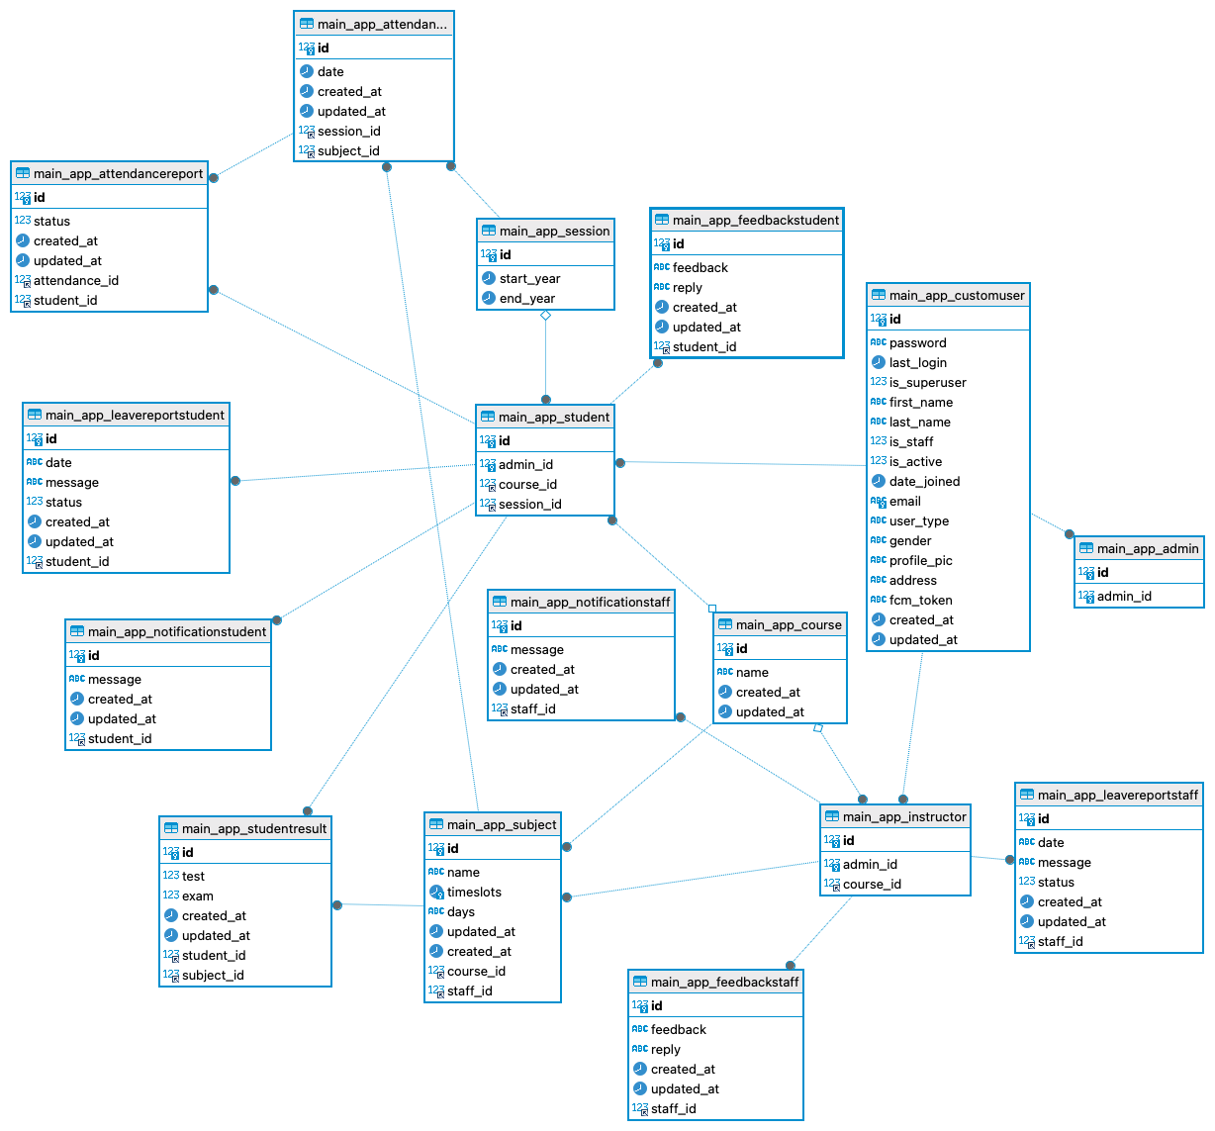
ER Diagram:

Slide 6
The Staff Panel:
In Result Management: Staff members can efficiently manage and input results for each student, maintaining a comprehensive record of academic performance.
Attendance Tracking: The system allows staff to take and view student attendance, streamlining the process of monitoring class participation.
Leave Applications: Staff members can apply for leave directly through the system, simplifying the administrative process and ensuring a swift workflow.

Slide 7
Notifications: The platform keeps staff abreast of critical developments, announcements, and updates, facilitating effective communication.
Feedback Mechanism: Staff members can actively engage in the feedback process, providing valuable insights and comments to administrators for continual improvement.
Transparent Communication: The Staff Panel enhances transparency by providing a centralized platform for communication, result management, and administrative tasks.

Slide 8
The Admin Panel:
Course Management: Administrators can efficiently manage courses, subjects, and sessions, establishing the foundational structure of the academic framework.
Student and Staff Management: The system provides a centralized hub for administrators to handle student and staff records, ensuring comprehensive and organized management.
Attendance Oversight: Administrators can efficiently manage attendance records, offering insights into student engagement and participation.

Slide 9
Notification System: The platform incorporates a notification system, enabling administrators to disseminate critical information, updates, and announcements.
Leave Approval: Admins have the authority to approve staff leave applications, maintaining control over the scheduling and operational aspects of the educational institution.
Feedback Handling: The Admin Panel facilitates the collection of feedback from both students and staff, promoting a responsive and improvement-oriented institutional approach.
Comprehensive Oversight: Administrators can oversee various aspects of the educational ecosystem, ensuring smooth operations and fostering a conducive learning environment.

Slide 10
Technology Stack:
Backend Development with Python Django: The robust backend is powered by Python Django, providing a scalable and efficient framework for seamless application development.
Database Management using MySQL: MySQL serves as the database management system, ensuring secure and organized storage of student, staff, and administrative data.

Slide 11
Frontend Development with HTML, CSS, and Bootstrap: The frontend is developed using HTML, CSS, and Bootstrap, creating a visually appealing and responsive user interface across all devices.
AWS Deployment for Scalability: The application is deployed on Amazon Web Services (AWS), leveraging its cloud capabilities for scalability, reliability, and optimal performance.
Git for Version Control: Git, coupled with AWS CodeCommit, is employed for version control, allowing collaborative development and efficient management of codebase changes.

Slide 12
Deployment:
AWS Setup:
Created EC2 and RDS instances.
Assigned necessary permissions to a user.
Uploaded code to AWS CodeCommit.
Code Deployment:
Cloned code into EC2 instance.
Installed dependencies and atarted the server.
Security:
Modified security group settings.
Created API Gateway and integrated HTTP URI.

Slide 13
Conclusion:
The Student Management System, crafted with user-friendly interfaces, seamlessly merges student, staff, and administrative functionalities. With a focus on streamlined attendance management, efficient leave applications, and timely notifications, the system enhances the daily operations of educational institutions.
Developed on the robust Python Django framework and deployed on AWS, the platform ensures scalability and optimal performance. This integration not only facilitates seamless student-staff interaction but also transforms administrative processes.
The result is an agile, responsive, and efficient system that contributes to an elevated standard of academic administration and fosters an enriched educational experience.

